Slide 1
Safe Sequential Path Planning of Multi-Vehicle Systems
via Double-Obstacle Hamilton-Jacobi-Isaacs Variational Inequality
Mo Chen, Jaime Fisac, Shankar Sastry, Claire Tomlin
Notes:
Thanks for the introduction. I’ll be talking about [title]. This is joint work with Jaime Fisac, Shankar Sastry, and Claire Tomlin

Slide 2
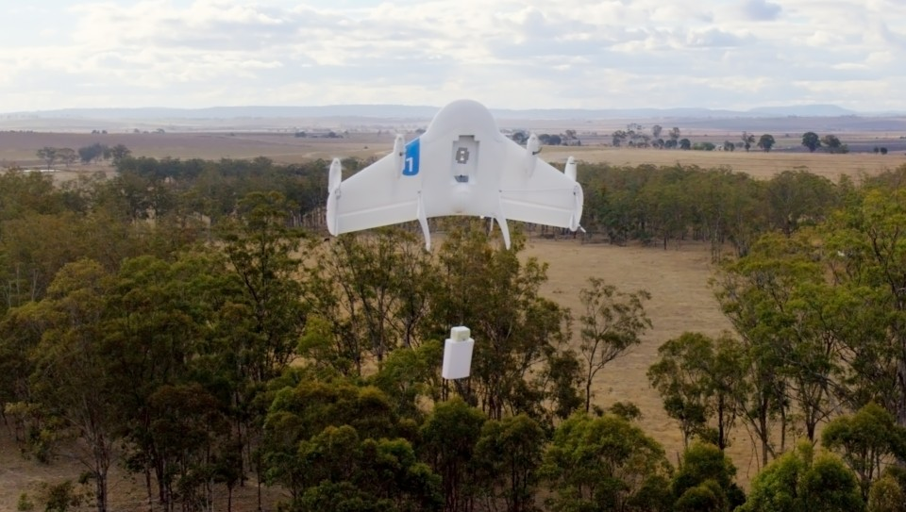
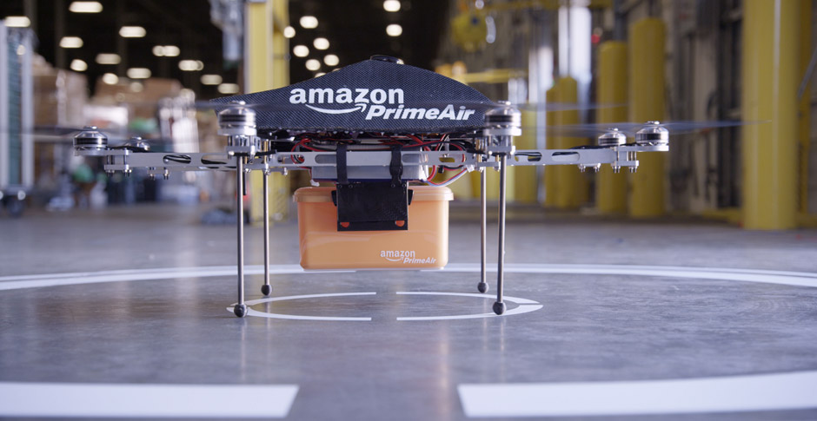

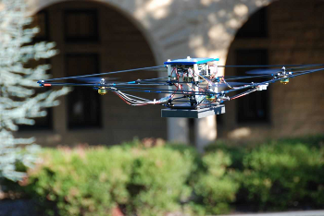

Motivation
Google Project Wing
Amazon Prime Air
Emergency Supply Delivery
Sport Spectating
Notes:
There has been a growing interest in using unmanned aerial vehicles, or UAVs for civil applications, as companies like Amazon and Google are looking in the near future to send unmanned aerial vehicles into the airspace to deliver packages. Because of this, government agencies such as NASA and the FAA are also very interested in analyzing these problems in order to prevent conflicts in the airspace with the introduction of potentially many UAVs in an urban environment.
UAVs can be used not only to deliver packages quickly, but in any situation where fast response is desired. For example UAVs can provide emergency supplies to disaster-struck areas that are otherwise difficult to reach.
In addition, one can even imagine potentially in the future, we could have UAVs following professional sport players to provide different viewing angles for television broadcasts.

Slide 3

Motivation
Projects like Amazon Prime Air has relatively high investment
Big concern: scalability
Example scenario
City with 2 million people
Each person requests drone delivery every 2 months
~35000 deliveries per day
30 minutes from warehouse to customer
Thousands of drones in the air simultaneously
Notes:
There are many challenges to using UAVs for such civil purposes, since projects like the Amazon Prime Air has relatively high investment. One big concern that these projects have is scalability

Slide 4
Motivation
Projects like Amazon Prime Air has relatively high investment
Big concern: scalability
Example scenario
City with 2 million people
Each person requests drone delivery every 2 months
~35000 deliveries per day
30 minutes from warehouse to customer
Thousands of drones in the air simultaneously
Notes:
Suppose we have a city with 2 million people, in which each person requests drone delivery every 2 months. A quick calculation reveals that this equates to about 35000 deliveries per day. Assuming that it takes 30 minutes for a UAV to fly from the warehouse to the customer, there could potentially be thousands of drones in the air simultaneously.

Slide 5
Outline
Reachability analysis
Hamilton-Jacobi Variational Inequalities
Sequential Path Planning
Two-vehicle system
Four-vehicle system
Notes:
In this talk, we look at how the problem of scalability can be addressed by reachability analysis. We will use Hamilton-Jacobi variational inequalities to perform sequential path planning, which will allow us to reduce the usual exponential complexity of analyzing multiple vehicles to linear complexity.

Slide 6
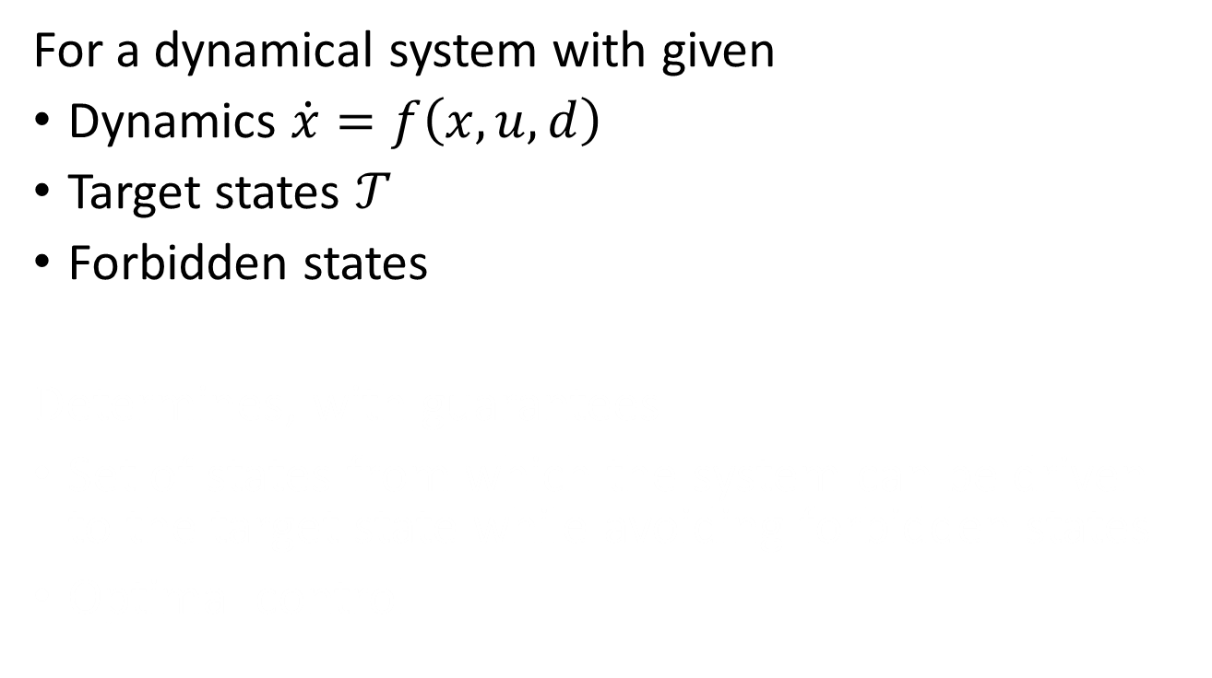
Reachability Analysis
For a dynamical system with given
Dynamics $\dot{x}=f\left(x,u,d\right)$
Target states $𝒯$
Forbidden states
Determines, with guarantees
Set of states from which the system can be driven to the target state while avoiding forbidden states
Optimal control
Reachable set
Target set
Notes:
First we’ll briefly discuss reachability.
Consider a dynamical system given by an ODE, and a target set specifying the desired states for a UAV, and forbidden states that constrain the states of a UAV.

Slide 7
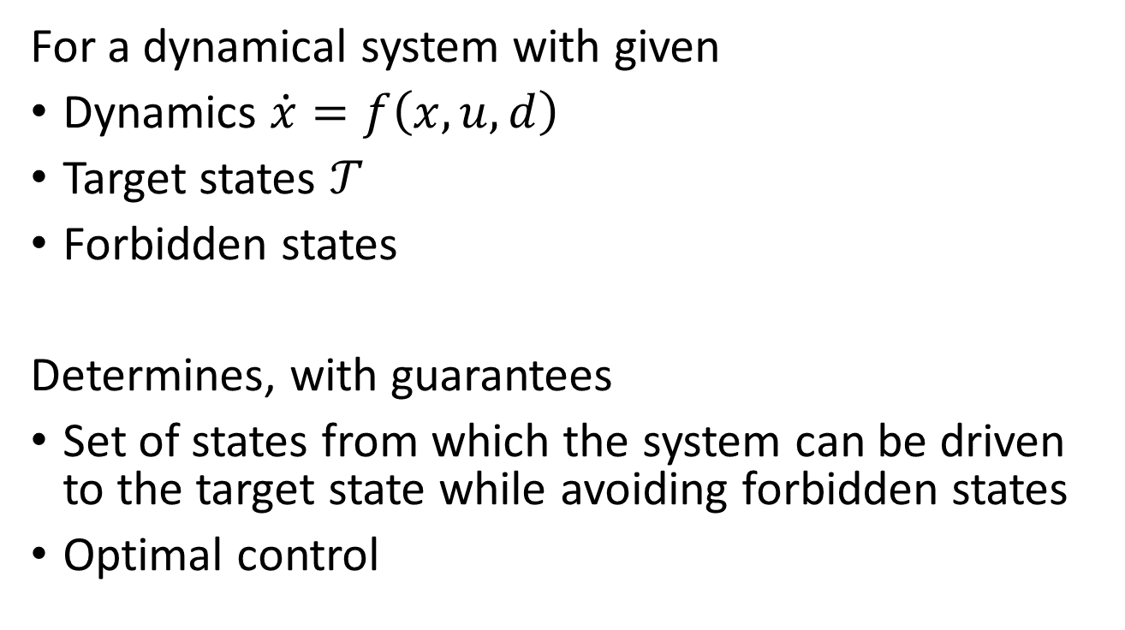
Reachability Analysis
For a dynamical system with given
Dynamics $\dot{x}=f\left(x,u,d\right)$
Target states $𝒯$
Forbidden states
Determines, with guarantees
Set of states from which the system can be driven to the target state while avoiding forbidden states
Optimal control
Reachable set
Target set
Notes:
In reachability analysis, we determine, with guarantees, the set of states from which the system can be driven to the target state while avoiding the forbidden states. We also obtain the optimal control which allows the system to arrive at the target set without ever going into the forbidden states.

Slide 8
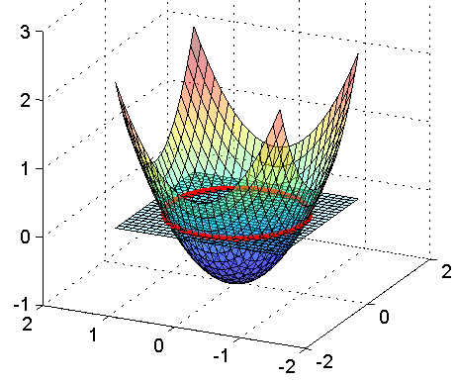
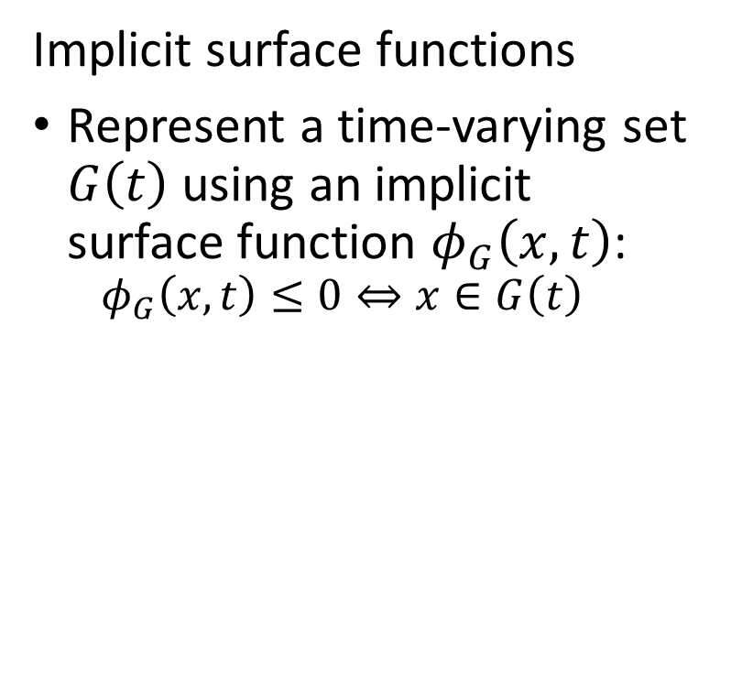
Hamilton-Jacobi Formulation
Implicit surface functions
Represent a time-varying set $G\left(t\right)$ using an implicit surface function $φ_{G}\left(x,t\right)$:
$$φ_{G}\left(x,t\right)≤0⇔x∈G\left(t\right)$$
Example: 2D unit disk centered at the origin:
$$φ_{G}\left(x,y\right)=x^{2}+y^{2}−1$$
Reachable set
Target set
Notes:
In the Hamilton-Jacobi formulation of reachability, sets are represented by the sub-0 level set of some function. A time-varying set, G(t), is represented by the implicit surface function phi_G(x,t) such that wherever phi_G(x,t)<=0, x is in G(t)

Slide 9
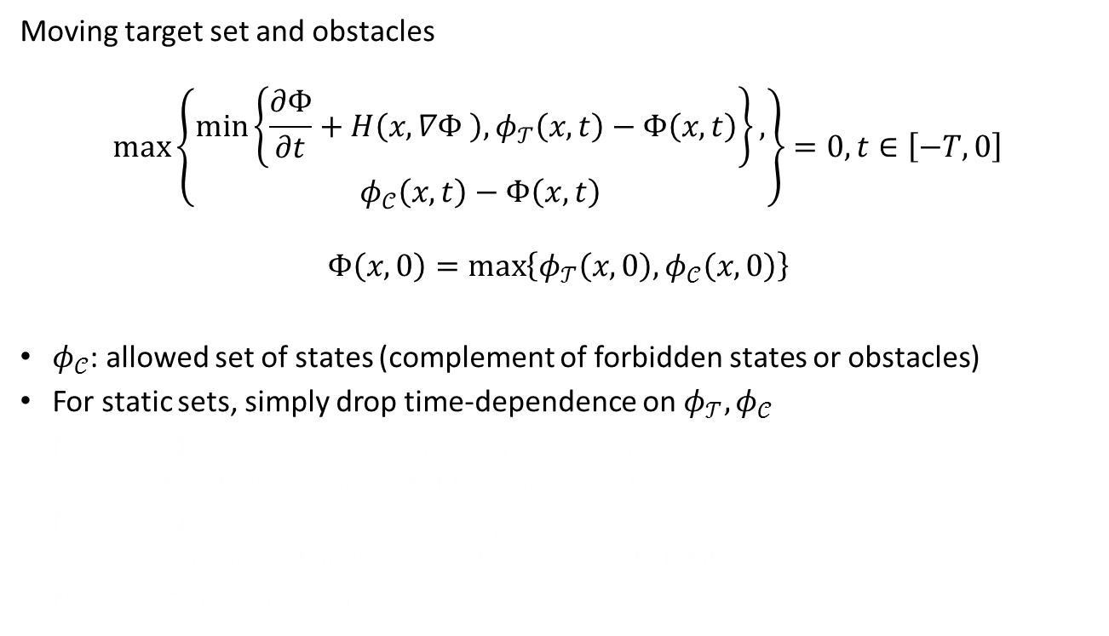
Double-Obstacle HJ Variational Inequalities^{[1]} (VI)
Moving target set and obstacles
$$\max\left\{\begin{aligned}\min\left\{\frac{∂Φ}{∂t}+H\left(x,∇Φ \right),φ_{𝒯}\left(x,t\right)−Φ\left(x,t\right)\right\}, \\ φ_{𝒞}\left(x,t\right)−Φ\left(x,t\right)\end{aligned}\right\}=0, t∈\left[−T,0\right]$$
$$Φ\left(x,0\right)=\max\left\{φ_{𝒯}\left(x,0\right),φ_{𝒞}\left(x,0\right)\right\}$$
$φ_{𝒞}$: allowed set of states (complement of forbidden states or obstacles)
For static sets, simply drop time-dependence on $φ_{𝒯},φ_{𝒞}$
Restricts $Φ$ to always be at most $φ_{𝒯}$ everywhere
The target set is always part of the reachable set
Restricts $Φ$ to always be at least $φ_{𝒞}$ everywhere
The reachable set must be inside the allowed set of states
No state augmentation
[1] J. F. Fisac, M. Chen, C. J. Tomlin, S. Sastry. (October 2014) Reach-Avoid Problems with Time-Varying Dynamics, Targets and Constraints. 18th International Conference on Hybrid Systems: Computation and Control, 2015.
Notes:
Once we define the time-varying implicit surface functions phi_T for the target set, and phi_C for the allowed set of states, the reachable set can obtained by solving this variational inequality.

Slide 10
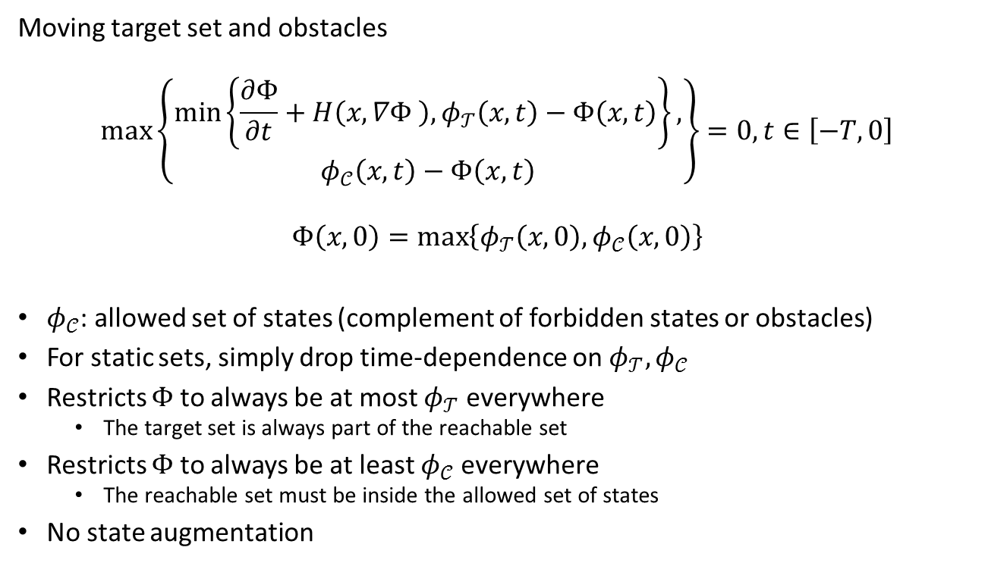
Double-Obstacle HJ Variational Inequalities^{[1]} (VI)
Moving target set and obstacles
$$\max\left\{\begin{aligned}\min\left\{\frac{∂Φ}{∂t}+H\left(x,∇Φ \right),φ_{𝒯}\left(x,t\right)−Φ\left(x,t\right)\right\}, \\ φ_{𝒞}\left(x,t\right)−Φ\left(x,t\right)\end{aligned}\right\}=0, t∈\left[−T,0\right]$$
$$Φ\left(x,0\right)=\max\left\{φ_{𝒯}\left(x,0\right),φ_{𝒞}\left(x,0\right)\right\}$$
$φ_{𝒞}$: allowed set of states (complement of forbidden states or obstacles)
For static sets, simply drop time-dependence on $φ_{𝒯},φ_{𝒞}$
Restricts $Φ$ to always be at most $φ_{𝒯}$ everywhere
The target set is always part of the reachable set
Restricts $Φ$ to always be at least $φ_{𝒞}$ everywhere
The reachable set must be inside the allowed set of states
No state augmentation
[1] J. F. Fisac, M. Chen, C. J. Tomlin, S. Sastry. (October 2014) Reach-Avoid Problems with Time-Varying Dynamics, Targets and Constraints. 18th International Conference on Hybrid Systems: Computation and Control, 2015.
Notes:
Starting from the inside minimum, the first part is a standard HJ PDE derived from dynamic programming. The second part keeps a history of whether a trajectory has ever been in the target set. In the outside maximum, the second part keeps a history of whether a trajectory has ever violated the consrtaints.
We solve this variational inequality backwards in time, starting from time 0 to time –T, and the solution big Phi(x,t) gives an implicit surface function that represents the reachable set.
Note that with this variational inequality, we are able to solve a problem involving time-varying sets without having to augment the state space with time. This is a great improvement in terms of computation complexity compared to previous methods.

Slide 11
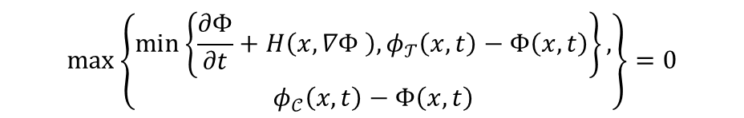
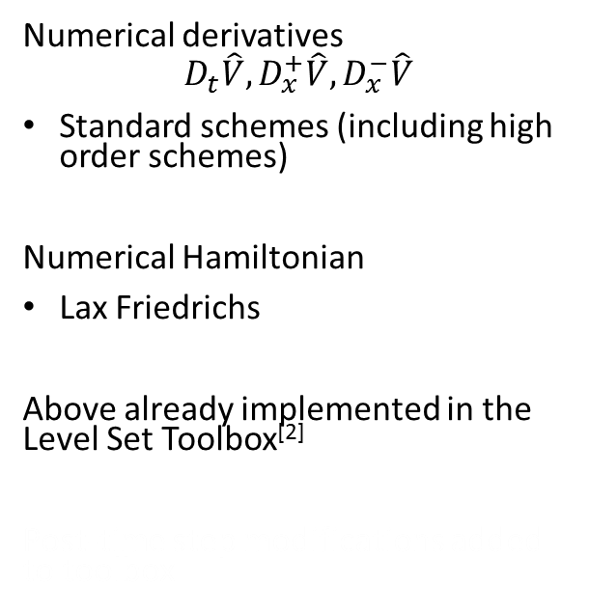
Numerical Implementation
Numerical derivatives
$$D_{t}\hat{V},D_{x}^{+}\hat{V},D_{x}^{−}\hat{V}$$
Standard schemes (including high order schemes)
Numerical Hamiltonian
Lax Friedrichs
Above already implemented in the Level Set Toolbox^{[2]}
Post-time step modifications added to toolbox
$$\max\left\{\begin{aligned}\min\left\{\frac{∂Φ}{∂t}+H\left(x,∇Φ \right),φ_{𝒯}\left(x,t\right)−Φ\left(x,t\right)\right\}, \\ φ_{𝒞}\left(x,t\right)−Φ\left(x,t\right)\end{aligned}\right\}=0$$
[2] I. Mitchell. "The Flexible, Extensible and Efficient Toolbox of Level Set Methods."
Notes:
To solve the variational inequality, we use standard finite difference schemes to approximate the spatial and temporal derivatives, and the Lax Friedrichs numerical Hamiltonian. All of these are already implemented in the Level Set Toolbox

Slide 12
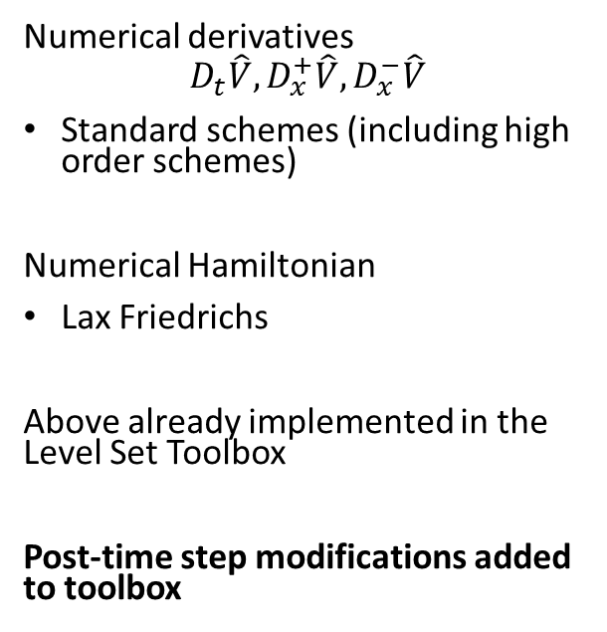
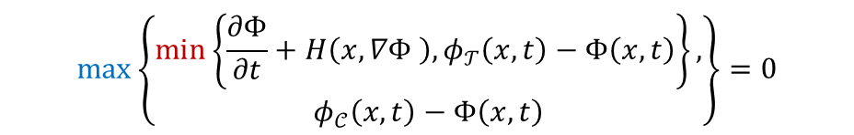
Numerical Implementation
Numerical derivatives
$$D_{t}\hat{V},D_{x}^{+}\hat{V},D_{x}^{−}\hat{V}$$
Standard schemes (including high order schemes)
Numerical Hamiltonian
Lax Friedrichs
Above already implemented in the Level Set Toolbox
Post-time step modifications added to toolbox
$$\max\left\{\begin{aligned}\min\left\{\frac{∂Φ}{∂t}+H\left(x,∇Φ \right),φ_{𝒯}\left(x,t\right)−Φ\left(x,t\right)\right\}, \\ φ_{𝒞}\left(x,t\right)−Φ\left(x,t\right)\end{aligned}\right\}=0$$
[2] I. Mitchell. "The Flexible, Extensible and Efficient Toolbox of Level Set Methods."
Notes:
A minor modification in the post-time step processing of the level set toolbox allows us to capture the maximum and minimum in the variational inequality.

Slide 13
Outline
Reachability analysis
Hamilton-Jacobi Variational Inequalities
Sequential Path Planning
Two-vehicle system
Four-vehicle system
Notes:
Next, we will apply the variational inequality to our sequential path planning problem

Slide 14




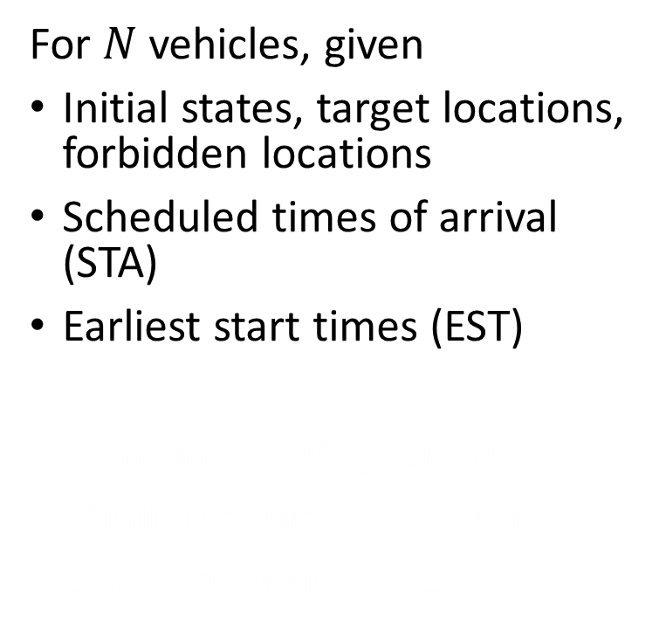
Sequential Path Planning
For $N$ vehicles, given
Initial states, target locations, forbidden locations
Scheduled times of arrival (STA)
Earliest start times (EST)
Determine, with guarantees
Minimum-time trajectories
Latest start times (LST)
Forbidden
Targets
Vehicle
Danger zone
Notes:
In sequential path planning, we consider N vehicles with given initial states (shown as the airplanes), target locations (shown as the circles of corresponding color), and forbideen states (shown in black). Each vehicle has a scheduled time of arrival and an earliest start time.

Slide 15
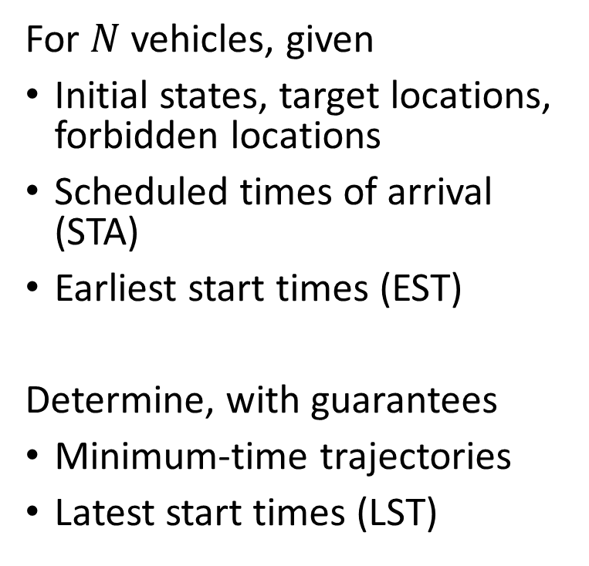
Sequential Path Planning
For $N$ vehicles, given
Initial states, target locations, forbidden locations
Scheduled times of arrival (STA)
Earliest start times (EST)
Determine, with guarantees
Minimum-time trajectories
Latest start times (LST)
Forbidden
Targets
Vehicle
Danger zone
Notes:
We’d like to determine, with guarantees, the minimum-time trajectories for each of the vehicles such that no vehicles come within the danger zone of another, and the latest start times that will allow each vehicle to arrive at the target on schedule.

Slide 16
Approximate Solution
Joint optimal solution is intractable
Sequential path planning
Assign vehicle priorities
Treat higher-priority vehicles as moving obstacles
Forbidden
Targets
Vehicle
Danger zone
Notes:
A joint optimal solution is intractable, as dynamic programming scales exponentially with the number of states, and hence the number of vehicles.
In sequential path planning, we assign a priority to each vehicle, and for each vehicle, treat higher-priority vehicles as moving obstacles. Once higher priority vehicles have declared their trajectories, the optimal trajectory and optimal control for the next vehicle can be computed using the variational inequality in the state space of a single vehicle. This procedure reduces the computation complexity to scale linearly with the number of vehicles.

Slide 17
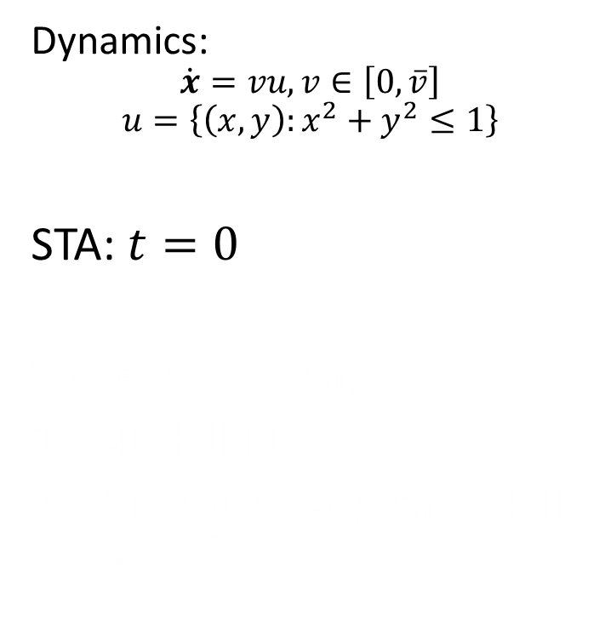
Two-Vehicle Example
Dynamics:
$$\dot{x}=vu,v∈\left[0,\overline{v}\right]$$
$$u=\left\{\left(x,y\right):x^{2}+y^{2}≤1\right\}$$
STA: $t=0$
Solve in two ways
4D HJI PDE
2D double-obstacle HJI VI $×2$
Notes:
Now we’ll look at a two-vehicle example, where each vehicle can move in any direction up to some maximum speed.
The vehicles, shown as stars, aim to arrive at their targets, the square of the corresponding color, no later than t = 0. They both must avoid going within a distance of 1 of each other, and also avoid the black obstacles

Slide 18
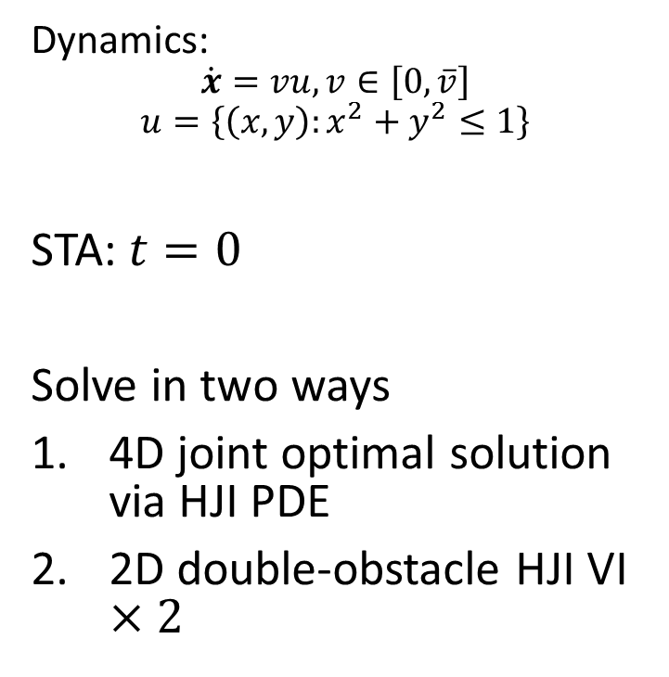
Two-Vehicle Example
Dynamics:
$$\dot{x}=vu,v∈\left[0,\overline{v}\right]$$
$$u=\left\{\left(x,y\right):x^{2}+y^{2}≤1\right\}$$
STA: $t=0$
Solve in two ways
4D joint optimal solution via HJI PDE
2D double-obstacle HJI VI $×2$
Notes:
We will first compute the joint optimal 4D solution for this problem, and then compute the approximate solution assuming the blue vehicle has higher priority

Slide 19
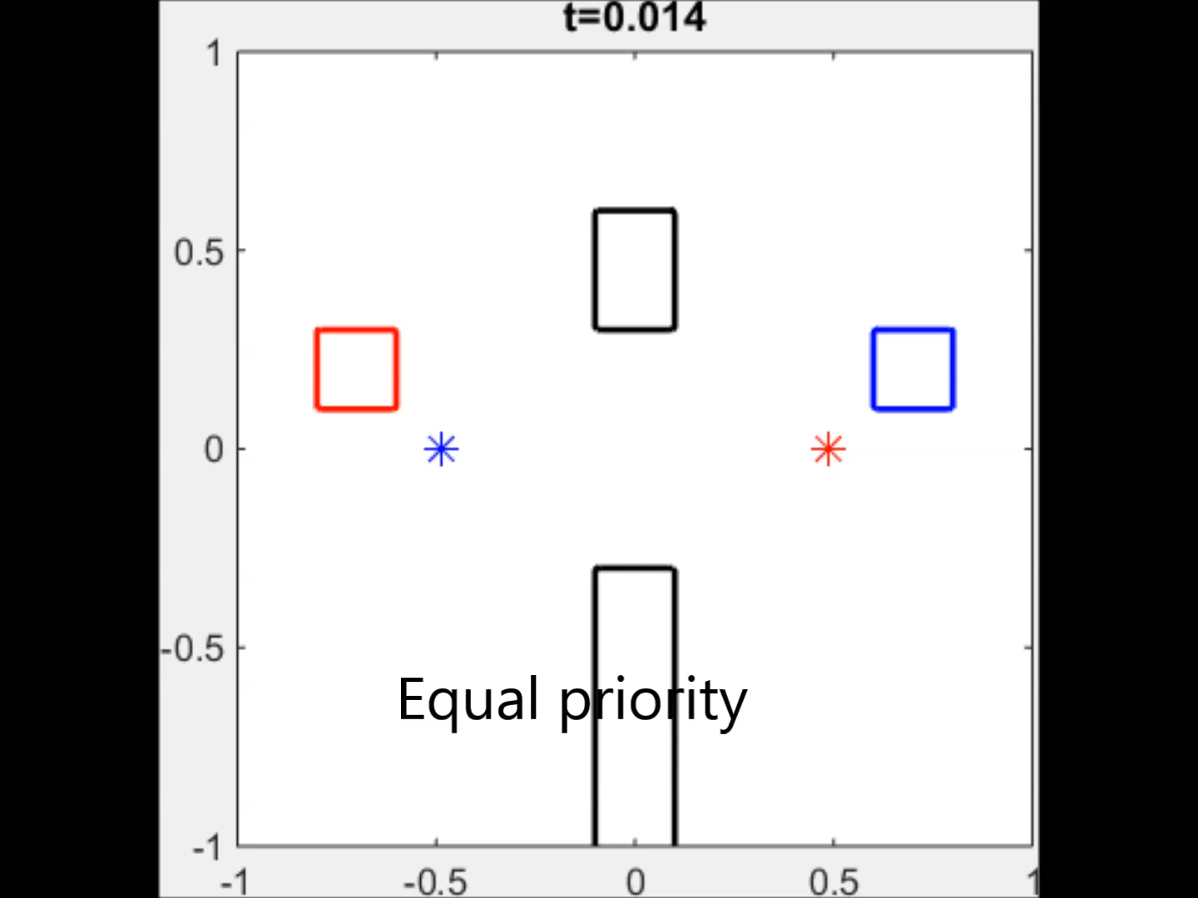
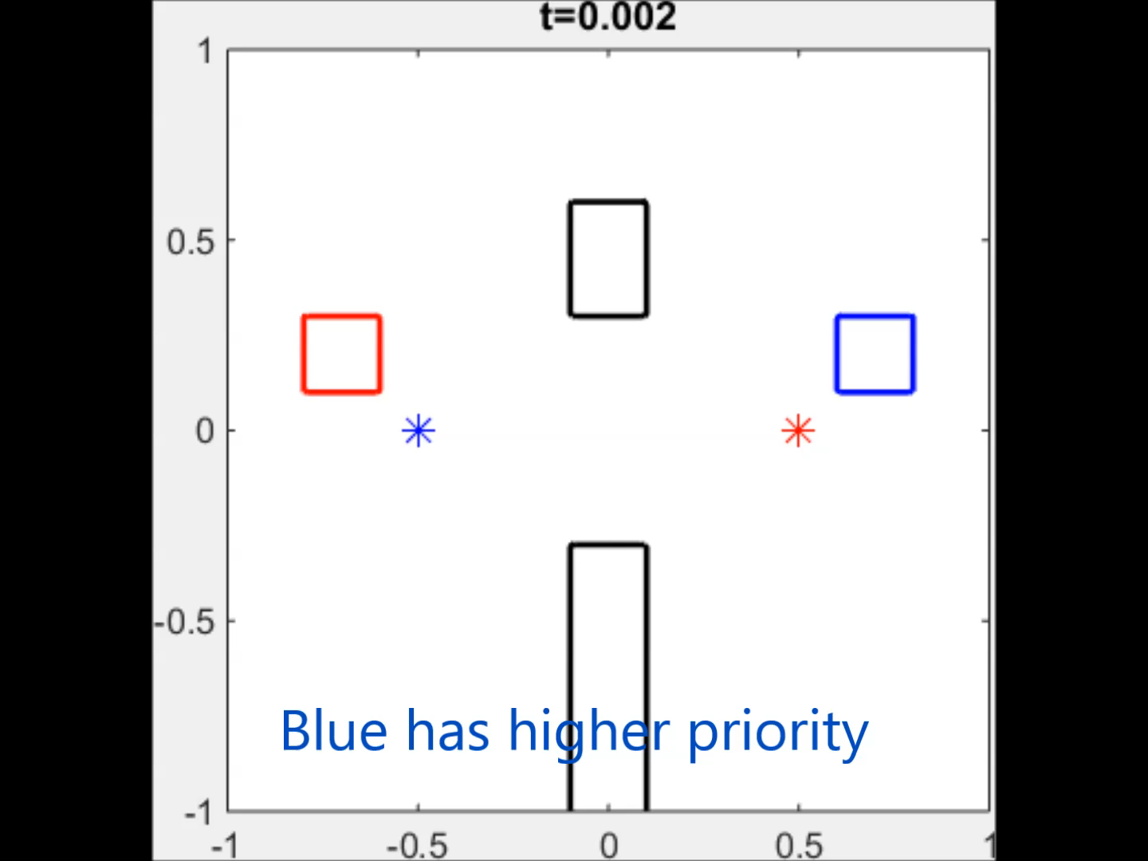

Results
Equal priority: Latest arrival at $t=1.15$
Prioritize blue: Latest arrival at $t=1.12$
Prioritization does not introduce much suboptimality
Equal priority computation is less accurate
Notes:
The joint optimal solution assumes that the two vehicles have equal priority. From the simulation, you can see that the vehicles avoid each other when they get close.
The approximate solution assumes that the blue vehicle has higher priority. In this case, we can see that the blue vehicle takes a straight-line path to its target, while the red vehicle optimally goes around the blue vehicle.

Slide 20
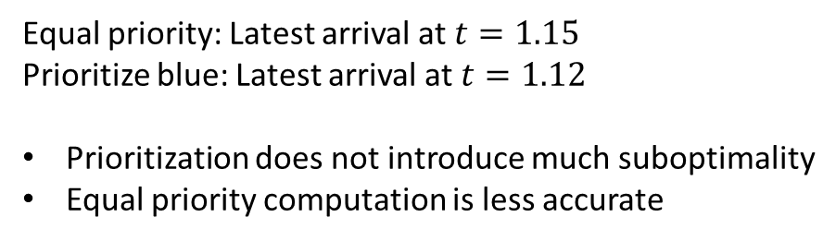
Results
Equal priority: Latest arrival at $t=1.15$
Prioritize blue: Latest arrival at $t=1.12$
Prioritization does not introduce much suboptimality
Equal priority computation is less accurate
Notes:
For both cases, the arrival time of the two vehicles are similar. This shows that prioritization does not introduce much suboptimality.
The joint optimal solution should yield an earlier time of arrival in theory; however, in practice, because of the joint optimal solution is computed in 4D as opposed to 2D, the grid resolution is much lower, leading to an inaccurate solution.

Slide 21
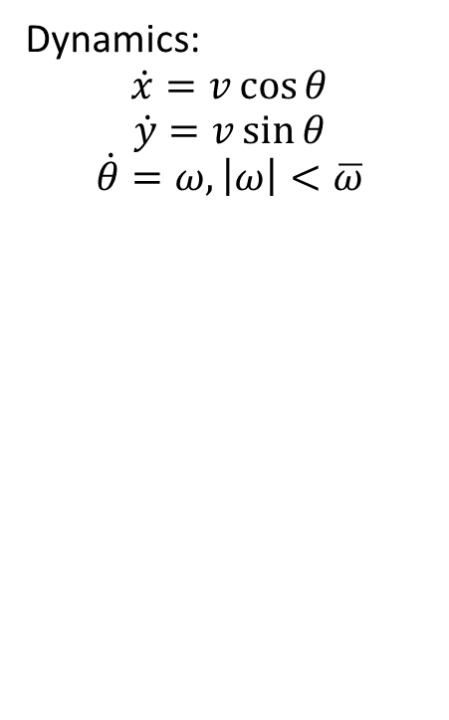
Four-Vehicle Example
Dynamics:
$$\dot{x}=v\cos{θ}$$
$$\dot{y}=v\sin{θ}$$
$$\dot{θ}=ω,\left|ω\right|<\overline{ω}$$
STAs
Notes:
We now look at a more realistic, 4-vehicle example, in which each vehicle has a constant speed and a bounded turn rate. The vehicles’ starting positions are shown as stars, and their initial headings are shown by the arrows. Each of them is trying to get to the circle of corresponding color, while avoiding the danger zones around other vehicles, shown as dashed circles, and avoiding the black rectangles.
Their scheduled times of arrival are listed in the table. 0 for blue, 0.2 for red, 0.4 for green, 0.6 for purple.

Slide 22
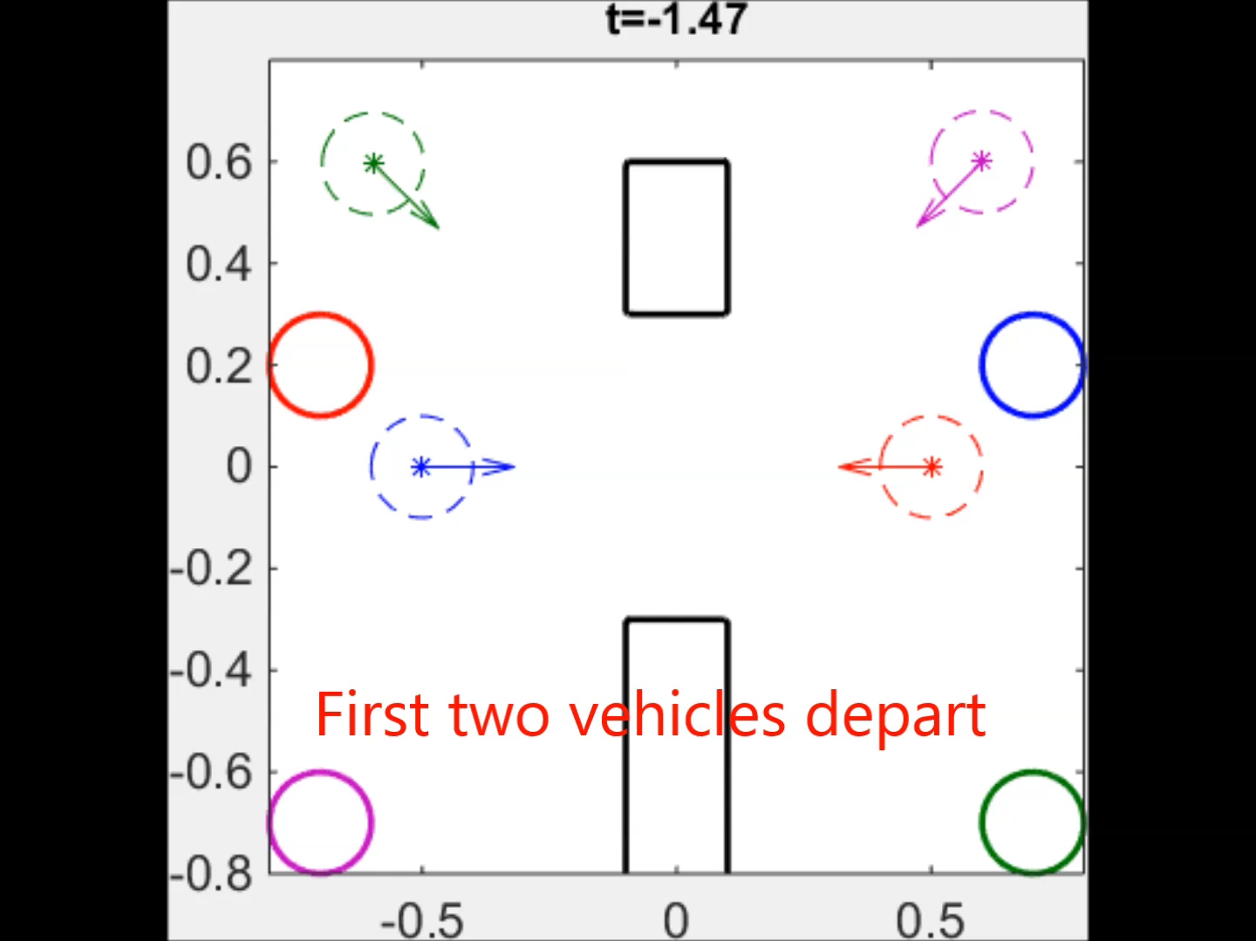
Trajectories
Notes:
Let’s take a look at the resulting trajectories and how the vehicles optimally avoid each other according to priority

Slide 23
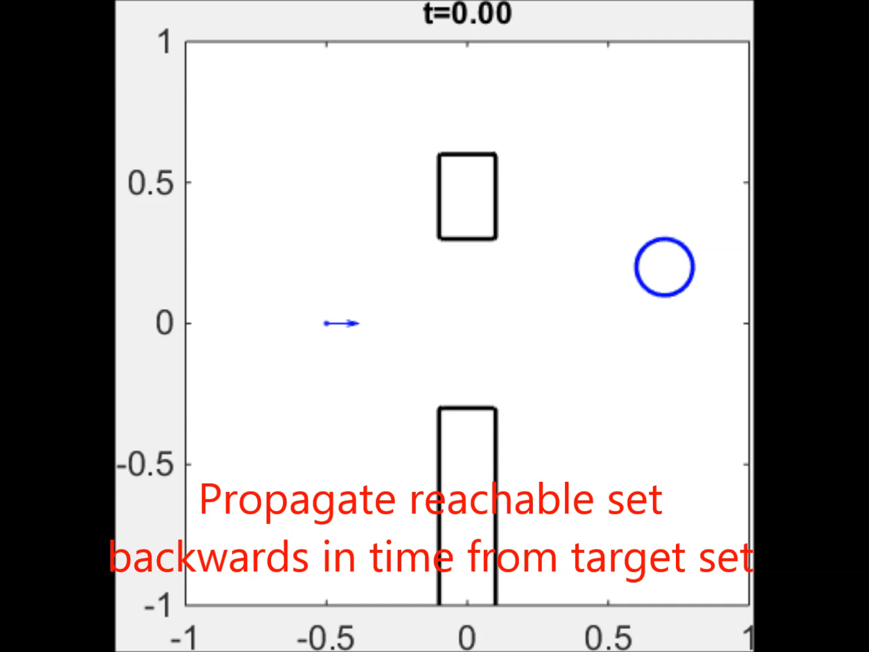
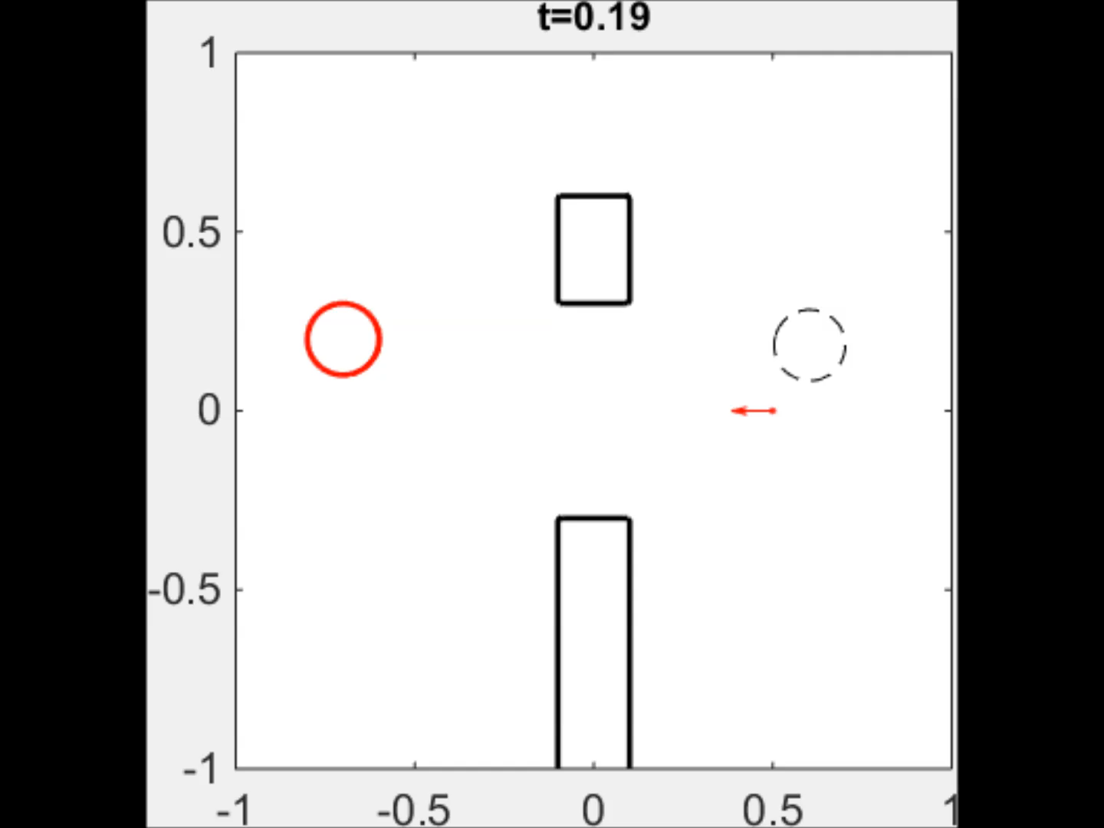
Reachable Set Time Evolution
Notes:
Let’s how look under the hood at the evolution of the reachable sets for each of the vehicles. The sets shown are 2D slices of the 3D reachable sets that we computed in the 3D state space of each vehicle.
Note that in each of the videos, the time starts from the scheduled time of arrival, and counts backwards until the latest start time.

Slide 24
Reach-Avoid Set Time Evolution
STAs and LSTs
Notes:
The resulting latest start times for each of the vehicles are shown in the table.

Slide 25
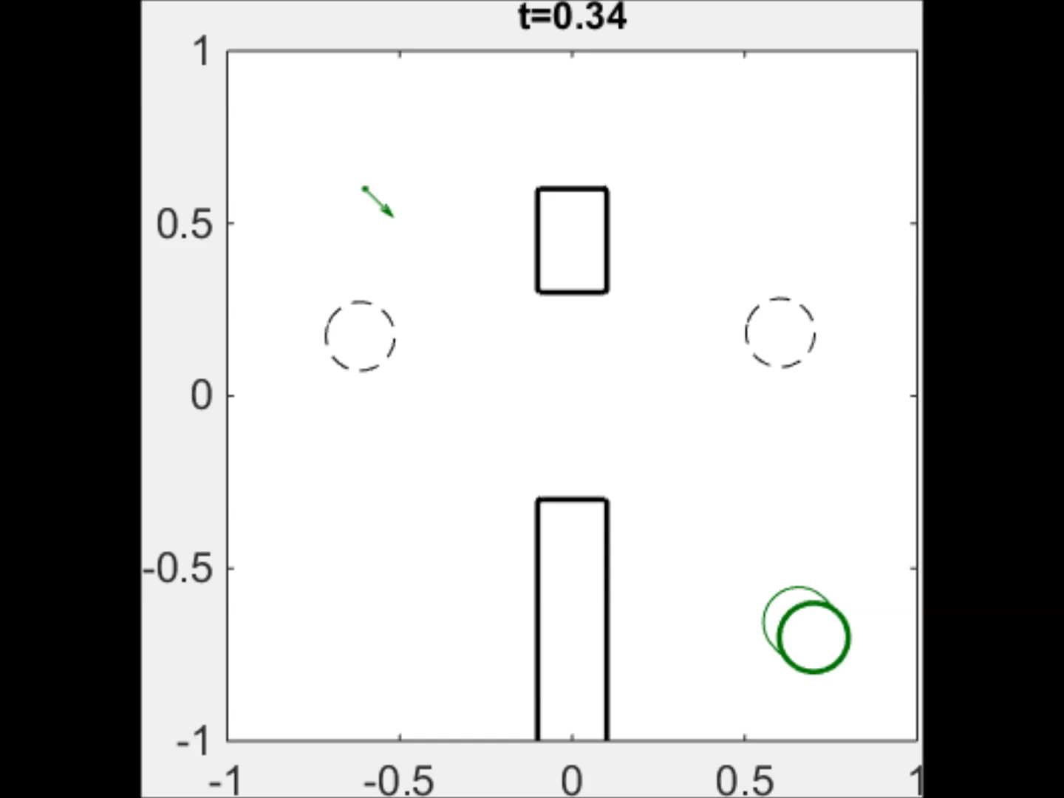
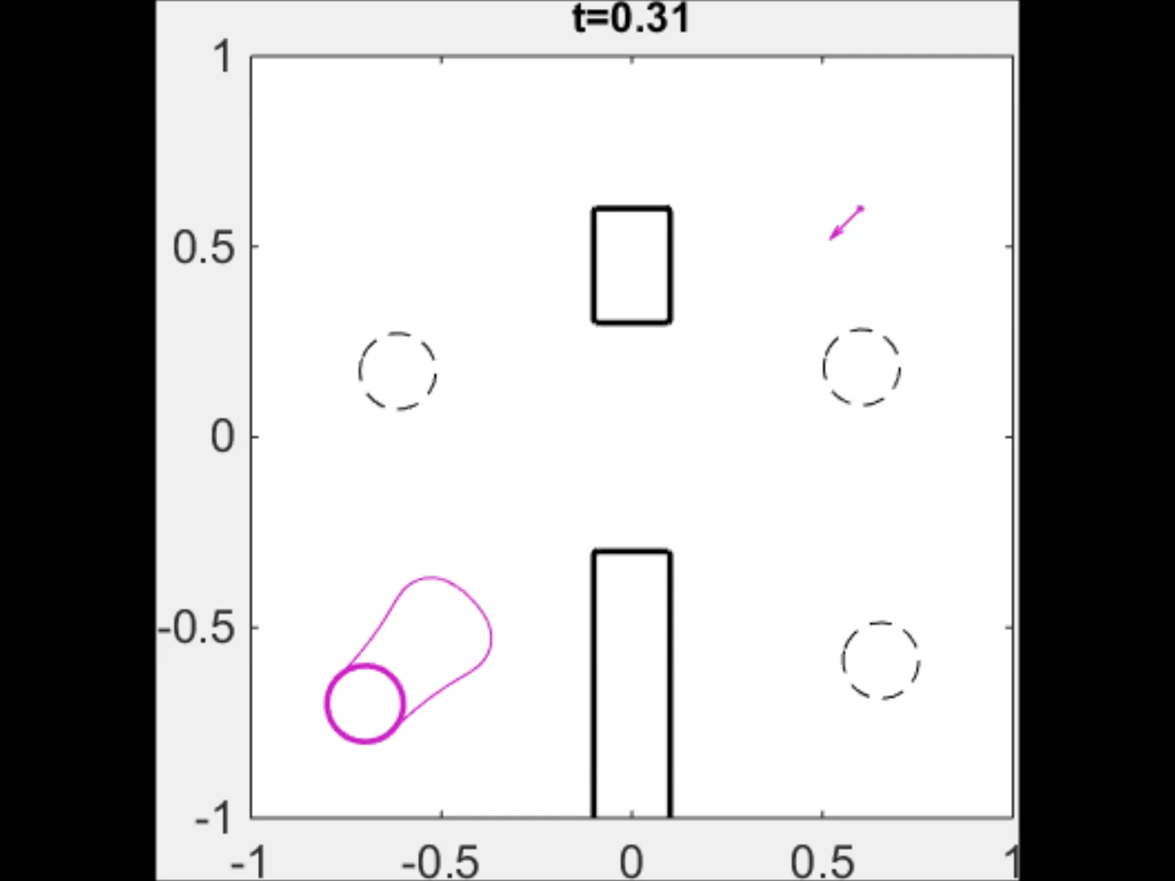
Reach-Avoid Set Time Evolution
STAs and LSTs
Notes:
We’ll finish by looking at the reachable set growth for the 3rd and 4th vehicles

Slide 26
Questions/comments?

